Slide 1
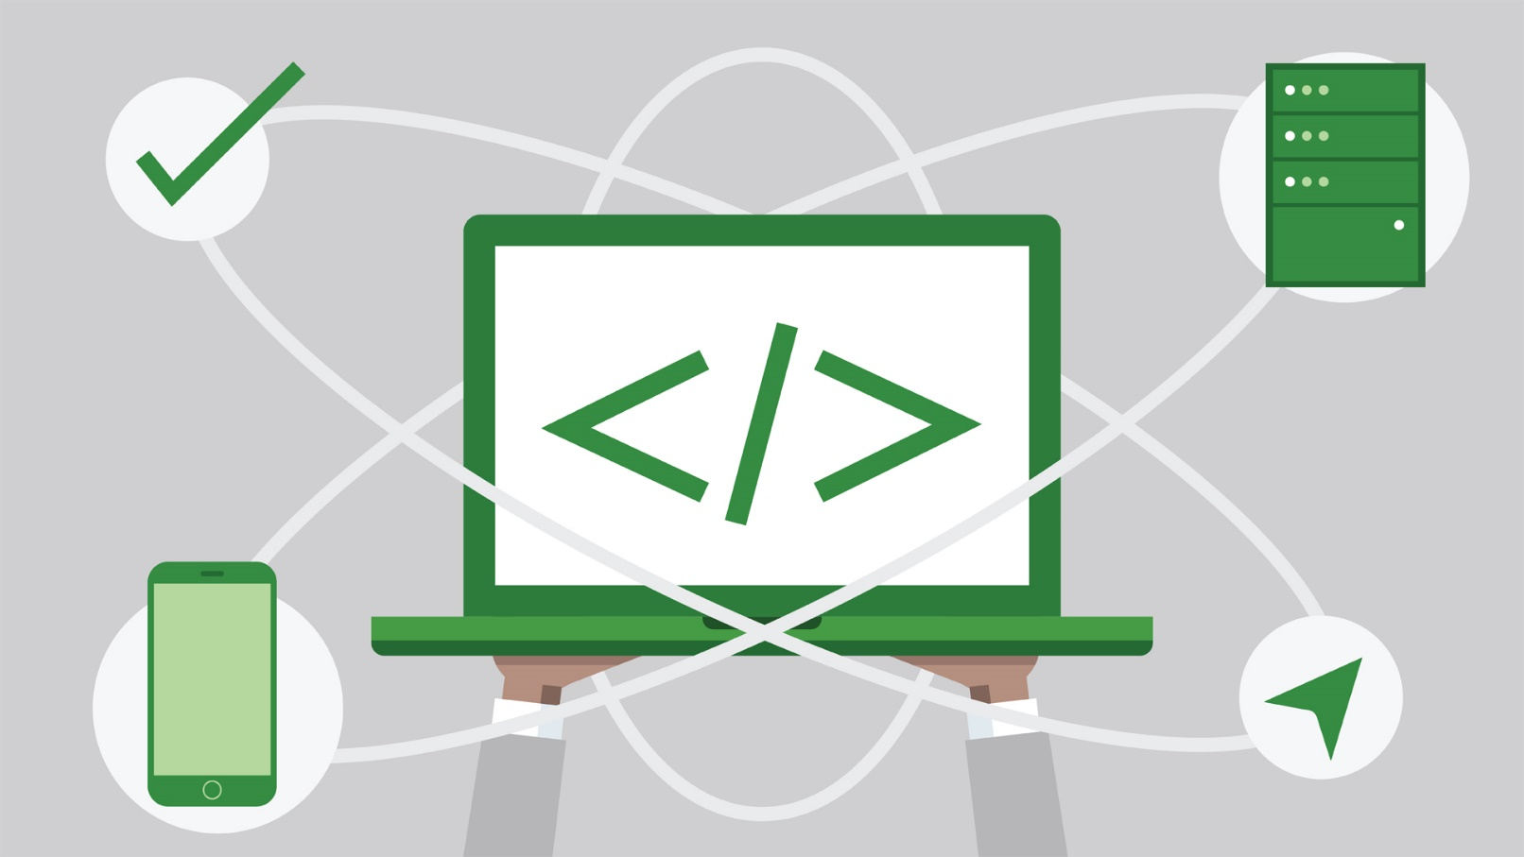
State Management
Cookies and Sessions
SoftUni Team
Technical Trainers
Software University
https://softuni.bg

Slide 2
Table of Content
HTTP Cookies
  Usage and Control
HTTP Sessions

Slide 3
Have a Question?
sli.do
#java-web

Slide 4

HTTP Cookies
Usages and Control

Slide 5


What Are Cookies?
A small file of plain text with no executable code
  Sent by the server to the client's browser
  Stored by the browser on the client's device (computer, tablet, etc.)
  Hold small piece of data for a particular client and a website

Slide 6

What Are Cookies Used for?
Session management
  Logins, shopping carts, game scores, or anything else the server
  should remember
Personalization
  User preferences, themes, and other custom settings
Tracking
  Recording and analyzing user behavior
Breakfast
  But that’s not what we are currently talking about

Slide 7


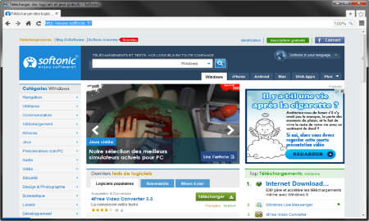



Session Management
The HTTP object is stateless
  It doesn’t store information about the requests
Web Client
Web Application
GET
POST
GET
Not stored

Slide 8
Stateless HTTP – the Problem
The server does not know if two requests come from the
same client
State management problems
  Navigation through pages requires authentication each time
  Information about the pages is lost between the requests
  Harder personalization of page functionality

Slide 9
Stateless HTTP – the Cookie Solution
A reliable mechanism for websites to remember stateful
information
  to know whether the user is logged in or not
  to know which account the user is logged in with
  to record the user's browsing activity
  to remember pieces of information previously entered into
  form fields (usernames, passwords, etc.)

Slide 10
How Are Cookies Used?
The response holds the cookies to be saved within the
Set-Cookie header
The request holds the specific web site cookie within the Cookie header
HTTP/1.1 200 OK
Set-Cookie: lang=en
GET /index HTTP/1.1
Cookie: lang=en

Slide 11
Server-Client Cookies Exchange
http://www.example.bg/
Web Client
Web Application
GET /index HTTP/1.1
HTTP/1.1 200 OK Set-Cookie: lang=en
GET /index HTTP/1.1
Cookie: lang=en

Slide 12
Cookie Structure
The cookie consists of Name, Value and Attributes (optional)
The attributes are key-value pairs with additional information
Attributes are not included in the requests
Attributes are used by the client to control the cookies
Name=Value
Attributes
Set-Cookie: SSID=Ap4P…GTEq; Domain=foo.com; Path=/; Expires=Wed, 13 Jan 2021 22:23:01 GMT; Secure; HttpOnly

Slide 13
Scope
Defined by the attributes Domain and Path
Domain – defines the website that the cookie belongs to
Path – Indicates a URL path that must exist in the requested
resource before sending the Cookie header
Set-Cookie: SSID=Ap4P…GTEq; Domain=foo.com; Path=/; Expires=Wed, 13 Jan 2021 22:23:01 GMT; Secure; HttpOnly

Slide 14
Lifetime
Defined by the attributes Expires and Max-Age
Expires – defines the date that the browser should
delete the cookie
By default the cookies are deleted after the end of the session
Max-Age – interval of seconds before the cookie is deleted
Set-Cookie: SSID=Ap4P…GTEq; Domain=foo.com; Path=/; Expires=Wed, 13 Jan 2021 22:23:01 GMT; Secure; HttpOnly

Slide 15
Security
Security flags do not have associated values
Security - tells the browser to use cookies only via
secure/encrypted connections
HttpOnly – defines that the cookie cannot be accessed via client-side scripting languages
Set-Cookie: SSID=Ap4P…GTEq; Domain=foo.com; Path=/; Expires=Wed, 13 Jan 2021 22:23:01 GMT; Secure; HttpOnly

Slide 16
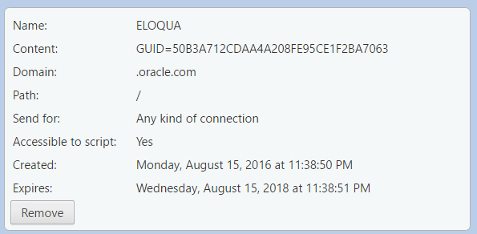
What is in the Cookie?
The cookie file contains a table with key-value pairs

Slide 17
Examine Your Cookies (1)
Most cookies are stored in a RDBMS, usually SQLite
Download SQLite browser from here
Location of Mozilla cookies
Location of Chrome cookies
C:\Users\{username}\AppData\Roaming\Mozilla\Firefox\Profiles\{name}.default\cookies.sqlite
C:\Users\{username}\AppData\Local\Google\Chrome\User Data\Default\Cookies

Slide 18
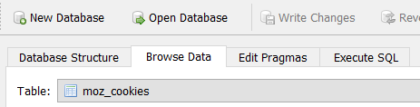
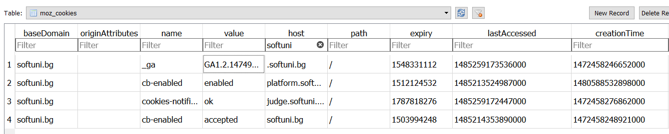
Examine Your Cookies (2)
Open the file with the SQLite browser
Browse the cookies table
Name
Host
Expiration date
Created on
Value
Paths
Last accessed on

Slide 19
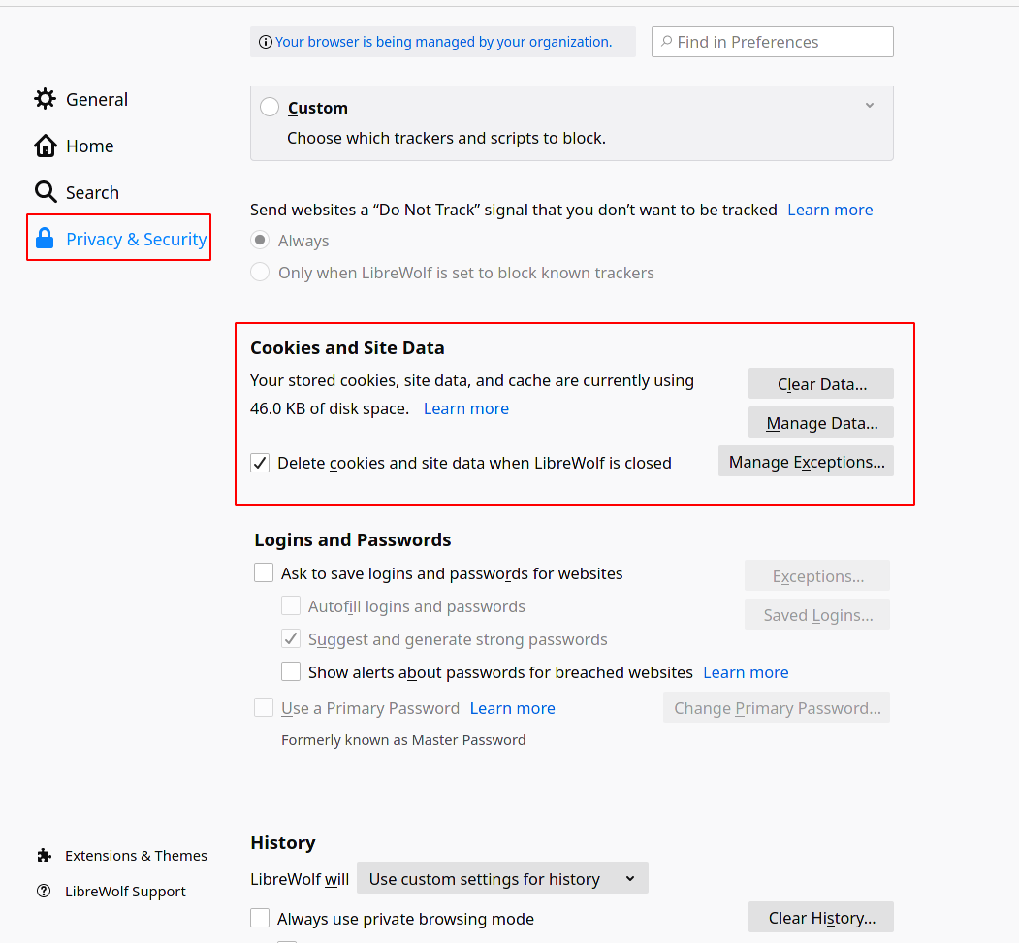
Control Your Cookies – Firefox Browser (1)

Slide 20
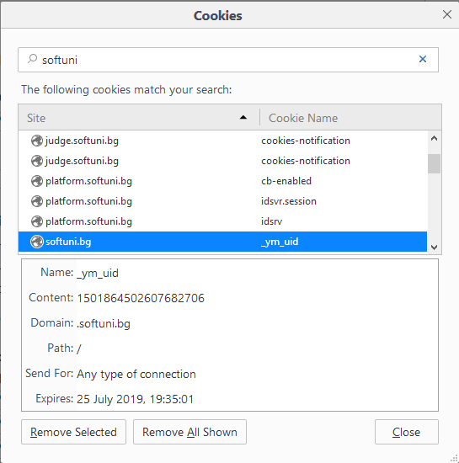
Control Your Cookies – Firefox Browser (2)
Browse cookies from a selected website
Delete a particular cookie or all cookies

Slide 21
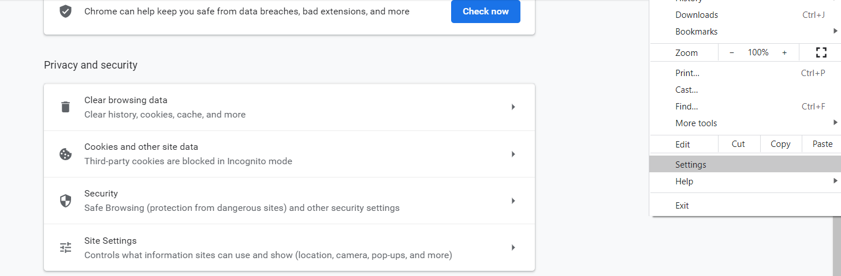
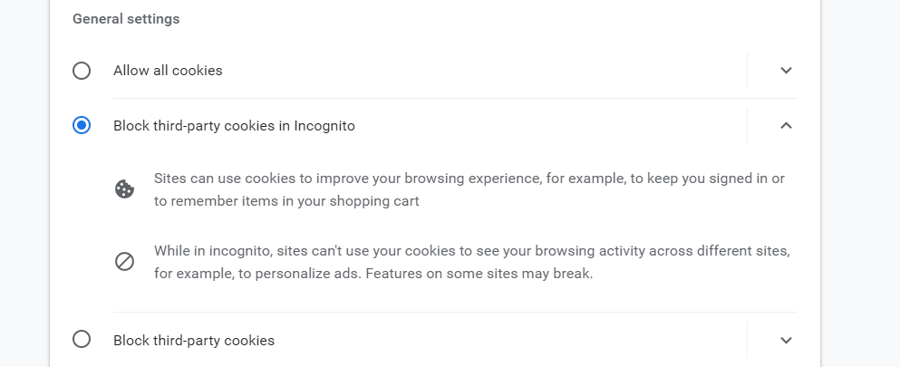
Control Your Cookies – Chrome Browser

Slide 22

Third Party Cookies
Cookies stored by an external party (different domain)
Mainly used for advertising and tracking across the web
By the end of 2023, Google will stop the use of third-party cookies.
http://stackoverflow.com/
Web Client
Web Application
Cookie transfer
Cookie transfer
Third Party

Slide 23

Cookies
Live Demo

Slide 24

HTTP Sessions

Slide 25

What Are Sessions?
A way to store information about a user to be used across
multiple pages
/login
Web Application
Session
/home
user: Teo
/products

Slide 26
Session Management (1)
The exchange mechanism be used between the user and the
web application
First Time Login
Web Client
Web Application
User credentials
Session ID

Slide 27
Session Management (2)
The exchange mechanism be used between the user and the
web application
Browsing Pages
Web Client
Web Application
Session ID
Requested data

Slide 28
Session Management (3)
The exchange mechanism be used between the user and the
web application
Browsing pages after
the server is restarted
Web Client
Web Application
Session ID
Requested data

Slide 29
Relation with Cookies
Session Store
sid 5 {
uid: 101
}
sid 7 {
uid: 102
}
Cookie {
name: sid
value: 5
}
Validate
Req
Web Application
Session
Resp
Database
Cookie {
name: sid
value: 7
}
Req
Get data
uid name
101 Teo
102 Bojo
Resp
Create personal web page

Slide 30
Session Structure
"hje85d3" : {
user_id: 789
username: FirstUser
},
"af354dd" : {
user_id: 456
username: SecondUser
},
"fg78e5s" : {
user_id: 654
username: ThirdUser
}
Unique
Session ID
Key-Value pairs with user data

Slide 31
Sessions
Live Demo

Slide 32

Summary
Cookies are client based stored information
  They are created by web applications
  Browser sends them back to the application
Sessions are server based information
  They are used across multiple pages
  Stores important info about the client
…
…
…

Slide 33
Questions?
Notes:
33

Slide 34














SoftUni Diamond Partners

Slide 35

Educational Partners

Slide 36
Trainings @ Software University (SoftUni)
Software University – High-Quality Education, Profession and Job for Software Developers
  softuni.bg, about.softuni.bg
Software University Foundation
  softuni.foundation
Software University @ Facebook
  facebook.com/SoftwareUniversity
Software University Forums
  forum.softuni.bg
Notes:
36

Slide 37

License
This course (slides, examples, demos, exercises, homework, documents, videos and other assets) is copyrighted content
Unauthorized copy, reproduction or use is illegal
© SoftUni – https://about.softuni.bg/
© Software University – https://softuni.bg
Notes:
37

